Slide 1
The Community Builder’s Experiences Using Virtual Platform
STEM Programming
9/8/20
Our Education Progrgramming learned experiences

Slide 2

Quickly establish new routine for our residents

Slide 3

STEM PROGRAMMING

Slide 4
Programs provided twice a week
Extracting DNA from strawberries.
The second experiment was to determine germs on their hands by "contaminating" a piece of bread.
Observe mosquitos breeding.
Talked with a scientist about careers in science
.

Slide 5
Virtual STEM on ZOOM

Slide 6
What is DNA?

Slide 7
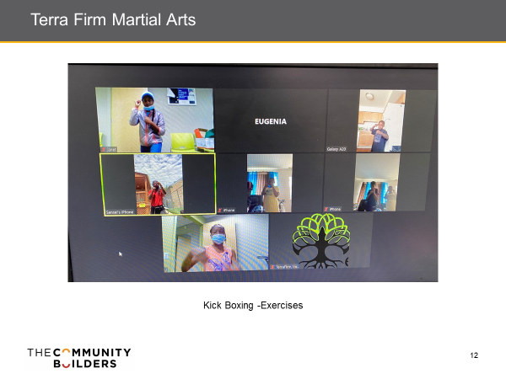
Weekly Youth Fitness via zoom

Slide 8
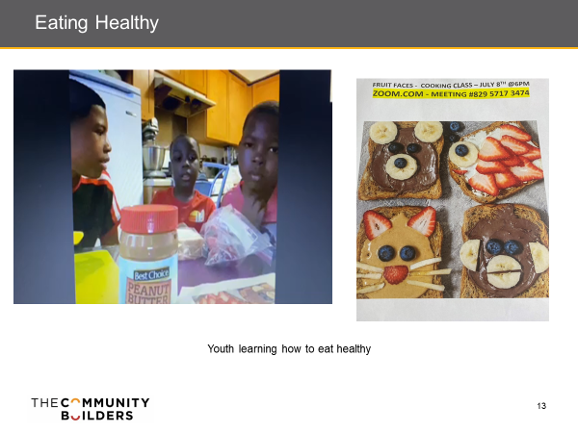
Youth Healthy eating via zoom

Slide 9
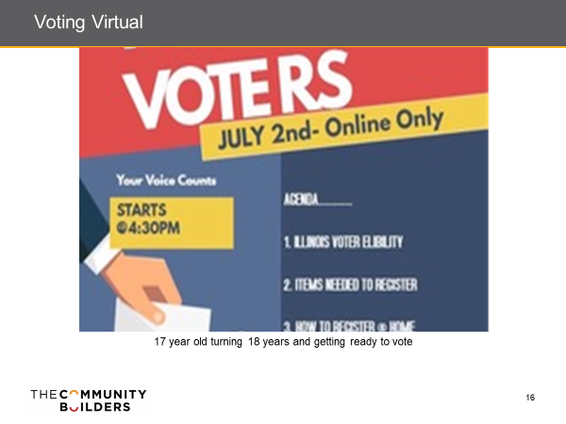

Slide 10
Short video
https://www.facebook.com/OakwoodShoresChicago/videos/2555339851271271/

Slide 11
What we have lerned

Slide 12
Our youth were exposed to careers in science
Listened and learned from the comfort of their homes.
The STEM program allowed young people to connect with each other virtual in ways that normally wouldn’t have taken place.
They learned a lot because (provided with reading materials prior to the session) they askes a lot of questions.
The lessons were interactive and fun
They enjoyed themselves.

Slide 13
Online STEM RESOURCES
Ohio’s 4-H has developed this series of videos to support robotics during the pandemic: https://www.ohio4h.org/statewide-programs/4-h-science/robotics/robotics-1-ev3
This program does require purchase of their Robotics 1 curriculum and robot. Purchasing information is here: https://www.ohio4h.org/robotics
Nebraska’s 4-H has put together online “boredom buster” workshops: https://4h.unl.edu/boredom-buster-challenge
Not all are STEM-related but all look pretty fun.
CalPoly also has their Learn By Doing Lab, which is providing online workshops: https://cesame.calpoly.edu/lbdl-virtual-kitchen-science-2020

