Slide 1



Meeting Objectives and Network Update
Housing counseling Meeting

Slide 2
Overview
Welcome
Meeting Logistics
Introductions
Network Update
Meeting Objectives

Slide 3
Network Updates
Certification Reminder:
Final Rule Issued in December 2016
Certification Deadline August 1, 2020
Requires that:
    All HUD approve agencies have at least 1 certified counselor and
    All counseling provided in connection with HUD programs must be by a HUD certified counselor

Slide 4

Network Updates
Industry Certification Data:
  Data is probably underreported due to counselors not in FHA database

Slide 5
Network updates
Certification Updates:
  16 of 18 Network organizations have a HUD Certified Housing Counselor
      89% of Network prepared for August 2020 deadline
  61% of total Network counselors are certified
      This might be an underestimate due to requirement to register in FHA Connect

Slide 6
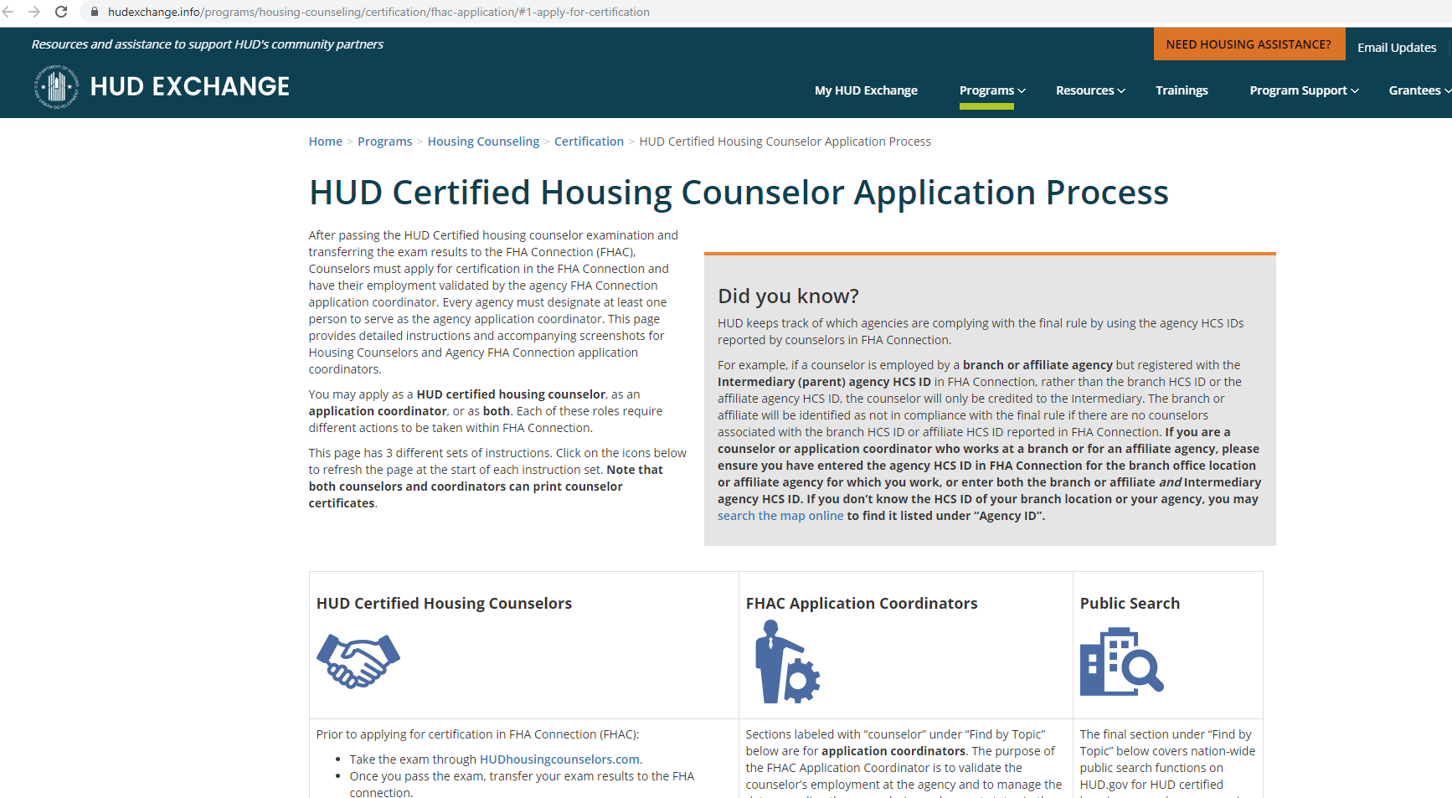
Network updates
Certification Process:
  Three parts: Taking the exam, Applying for Certification, FHA Coordinator verifies employment

Slide 7
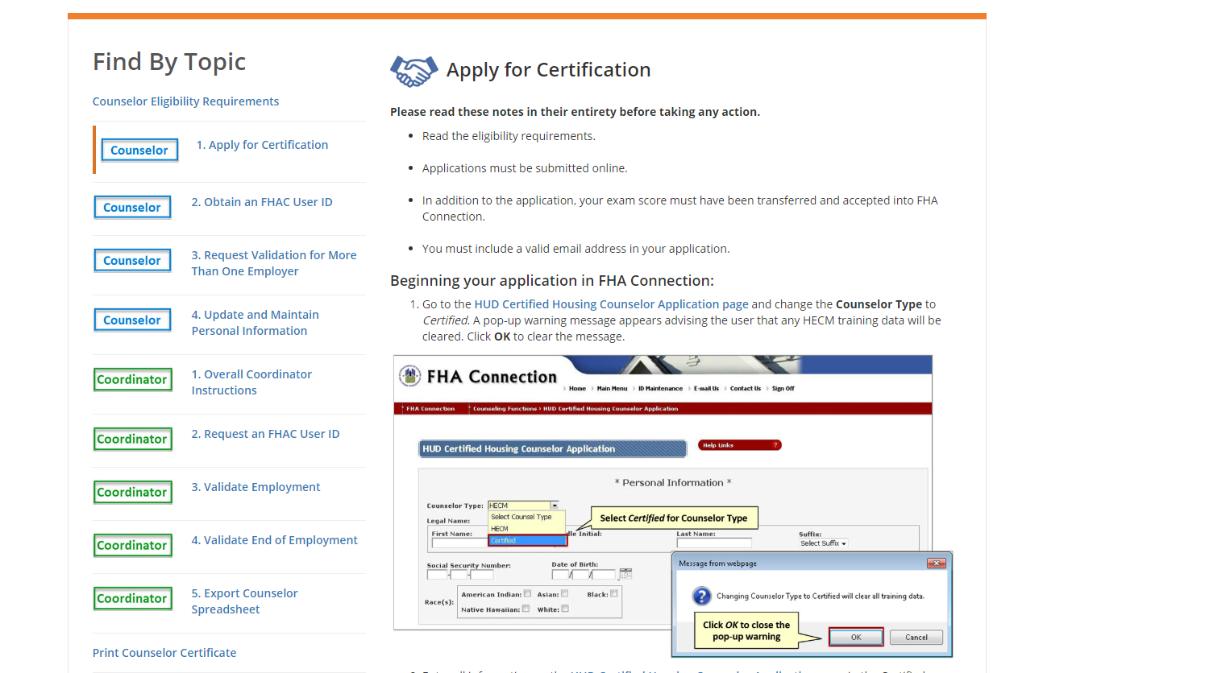
Network Updates
Certification Process

Slide 8
Network Updates
Certification Reminder Resources:
  Training resources available through HUD, NeighborWorks, Unidos, and more
  HUD can assist with FHA Connect issues
  Please reach out if you need additional resources

Slide 9

Network updates
Areas of Interest for HUD
  Reporting:
      Data Error Alerts as of June 2019
      Emphasis on Outcomes
  Agency Oversight
  HCS Profile Validation
  New Work Plan Template
!

Slide 10
Network Updates
Network Changes:
  Network seeing steady decline of participating agencies and agencies receiving HUD Grant

Slide 11


Network Information
FY19 OVERVIEW
Served 23,273
Decrease from FY17
Counseled 6,551
Increase from FY17
Avoided Foreclosure 73%
Increase from FY17
HEALTHCARE
Individuals Served Annually at Financed Health Centers

Slide 12
Network Information
FY19 Counseling Services Breakdown
772 Clients Purchased a Home
9% of Pre Purchase Clients
280 Clients Prevented Disclosure
29% of Foreclosure Clients
HEALTHCARE
Individuals Served Annually at Financed Health Centers
Notes:
.

Slide 13



Network Information
FY19 Outcomes Overview
3,353 Clients Improved Their Financial Capacity
31% of Counseling Clients
772 Clients Purchased a Home
9% of Pre Purchase Clients
280 Clients Prevented Foreclosure
29% of Foreclosure Clients
HEALTHCARE
Individuals Served Annually at Financed Health Centers
Notes:
.

Slide 14
Network Trends
Network Counseling Production Over the Years

Slide 15
Network Trends
Network Education Production Over the Years

Slide 16
Network Trends
Network Reported Outcomes Compared to HUD

Slide 17
Meeting Objectives
Meeting Objectives
Topics for Reflection
  Business Needs and Ideas- How do you see your business model/organization evolving?
  Value of Industry Engagement- How do you see your organization and the Network engaging in industry wide discussions and initiatives?
  Value of Network- Where can we add the most value? Future ideas of calls or small groups of focus.

Slide 18

Thank you!
Thank you!

Slide 19
Housing counseling meeting
Industry update
Fee-for-Service and Technology Convening

Slide 20
RESPA Background
Real Estate Settlement Procedures Act (RESPA)
Act to provide disclosure of costs in real estate transactions and prohibit abusive practices
Section 8 designed to prevent kick-backs in mortgage transactions:
      No person shall give and no person shall accept any fee, kickback, or thing of value pursuant to any agreement or understanding, oral or otherwise, that business incident to or a part of a real estate settlement service involving a federally related mortgage loan shall be referred to any person.
Exceptions for goods and services actually provided
Concern from lenders and counseling agencies still a risk because of a ruling around payment for a referral fee
HUD sought clarity from the Consumer Finance Protection Board (CFPB)

Slide 21
No Action Letter and Development Progress Part 1
The No Action Letter published by CFPB and HUD on September 10, 2019 establishes that Lenders may pay Counseling Agencies a fee for clients referred from pre-purchase counseling programs.
The policy applies to “Participating Counseling Agencies,” a category that includes both counseling agencies and HUD-approved Intermediaries.
The policy establishes a cost-based standard for determining whether fees are permissible:
  Fees must be commensurate with the services actually provided, and
  Reasonable and Customary for the area.
HUD has since stated that lender/agency agreements will establish a baseline for “reasonable and customary” fees.
Slide courtesy of Matt Ribe National Foundation for Credit Counseling, from Technology Convening presentation

Slide 22
Cost of Counseling Framework
  Major Categories
Intake
First Counseling Session
Down Payment Application Work
Prepping Lender Documents
Further Counseling Sessions
Customer Prep Work & Follow-up between Appointments
Post-Closing Follow-up
Marketing
Company Overhead
Major Challenges
Capturing the details without getting caught in the minutiae.
Providing clear & precise categories to accommodate the broad variance in counseling services provided.
Slide courtesy of Matt Ribe National Foundation for Credit Counseling, from Technology Convening presentation

Slide 23
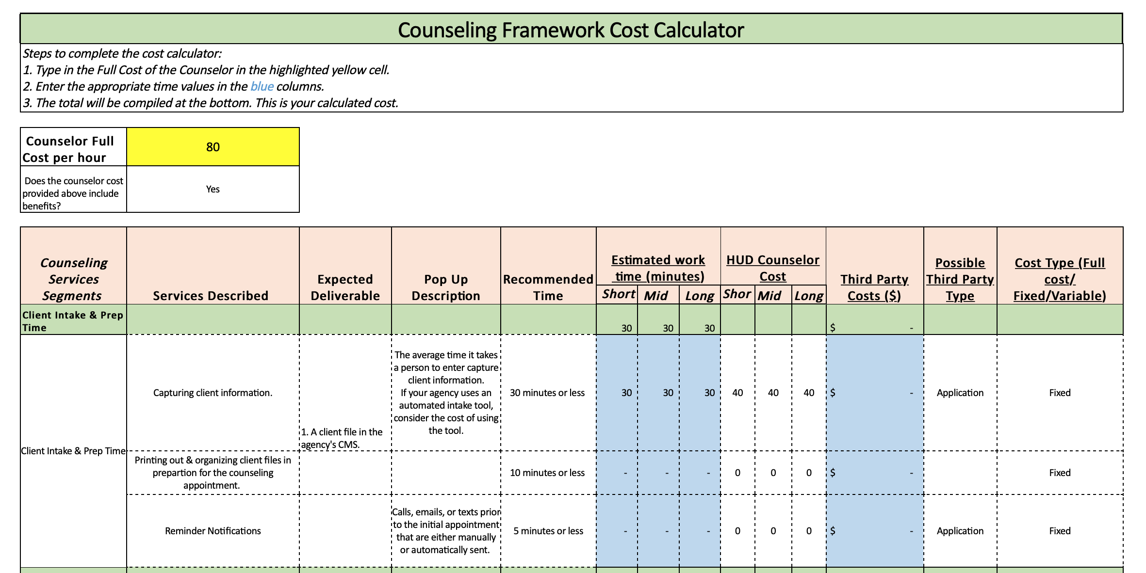
Cost of Counseling Framework
Cost of Counseling Framework
Slide courtesy of Matt Ribe National Foundation for Credit Counseling, from Technology Convening presentation

Slide 24
Housing counseling Technology convening
Technology Convening focused on data standardization in the counseling sector
Over 70 attendees:
    Housing counseling intermediaries and agencies
    CMS providers
    Federal partners—Freddie Mac, Fannie Mae and HUD
    Mortgage Bankers Association—MISMO
Benefits of Data Standardization:
    Ease implementation of fee-for-service implementation
    Enhance partnerships with private sector partners
    Demonstrate value of housing counseling.

Slide 25
Next steps identified
Develop a strategic plan for the counseling industry
Continue to identify the data fields necessary for the counseling industry
Work with MBA and MISMO on data standardization and lender engagement efforts
Engage with lenders and GSEs
Engage with HUD
Plan a follow up meeting

Slide 26
Remaining questions
How does the counseling industry support this work?
What will it take to get CMS systems compliant with a MISMO-based data standard?
What would a platform for data aggregation and business transactions look like and who would manage it?
For HPN—what is the role we should play?
Questions and Feedback?

Slide 27
Housing counseling Meeting

