Slide 1
Virtual Programming
COVID-19 Response - 2020

Slide 2

Jamboree is an Irvine, California based nonprofit corporation founded in 1990 and one of the nation’s largest owners of affordable housing.​
Mission ​
Jamboree delivers high quality affordable housing and services that transform lives and strengthen communities​

Slide 3

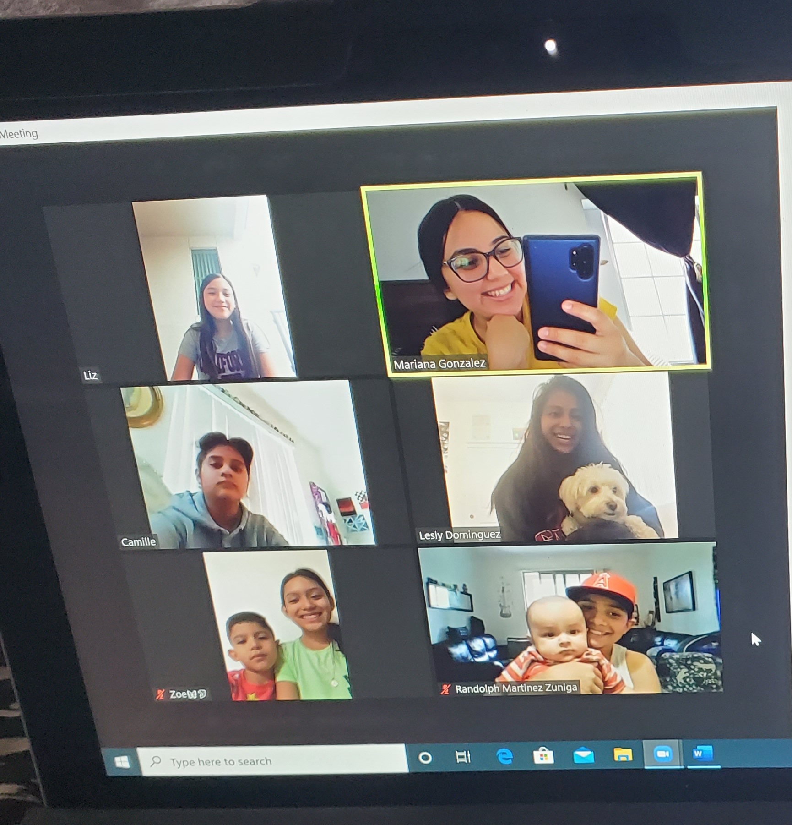
Summer 2019 -> Summer 2020

Slide 4
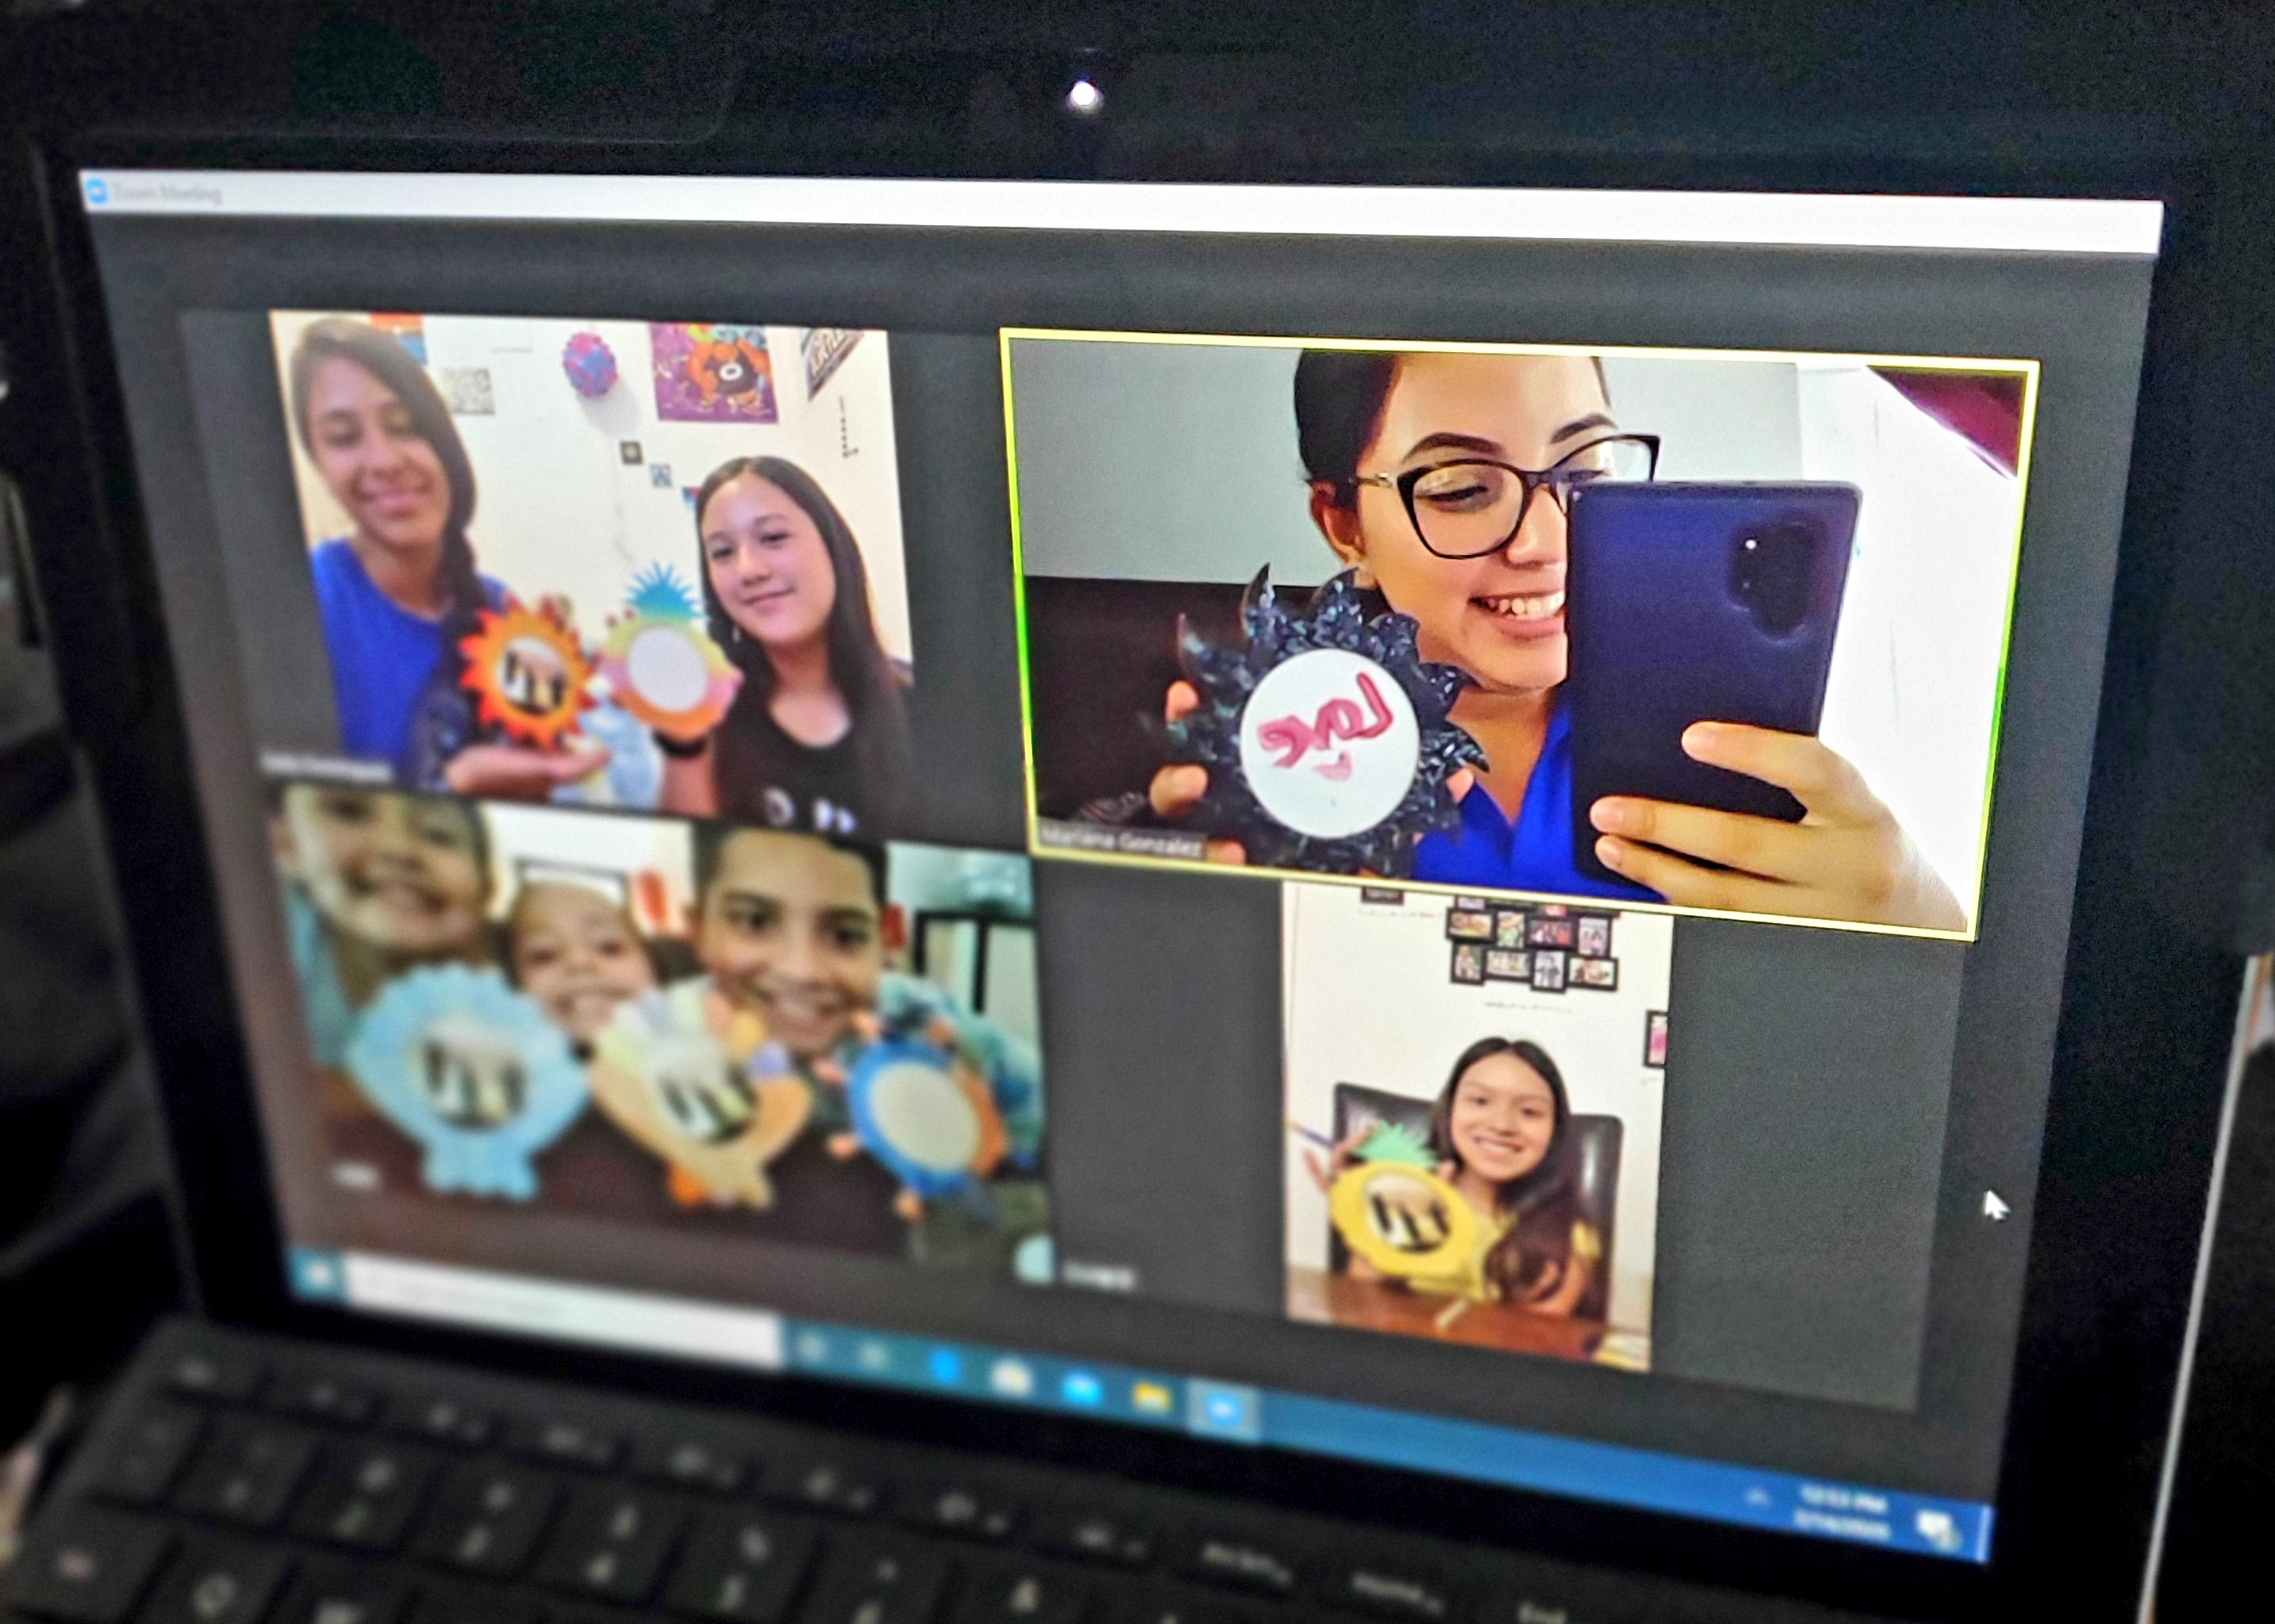

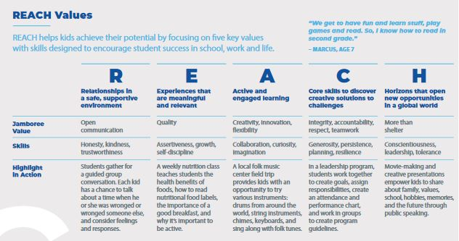

Create your own Planet activity with Mariana
Activity Kits to encourage our youth to participate virtually

Slide 5

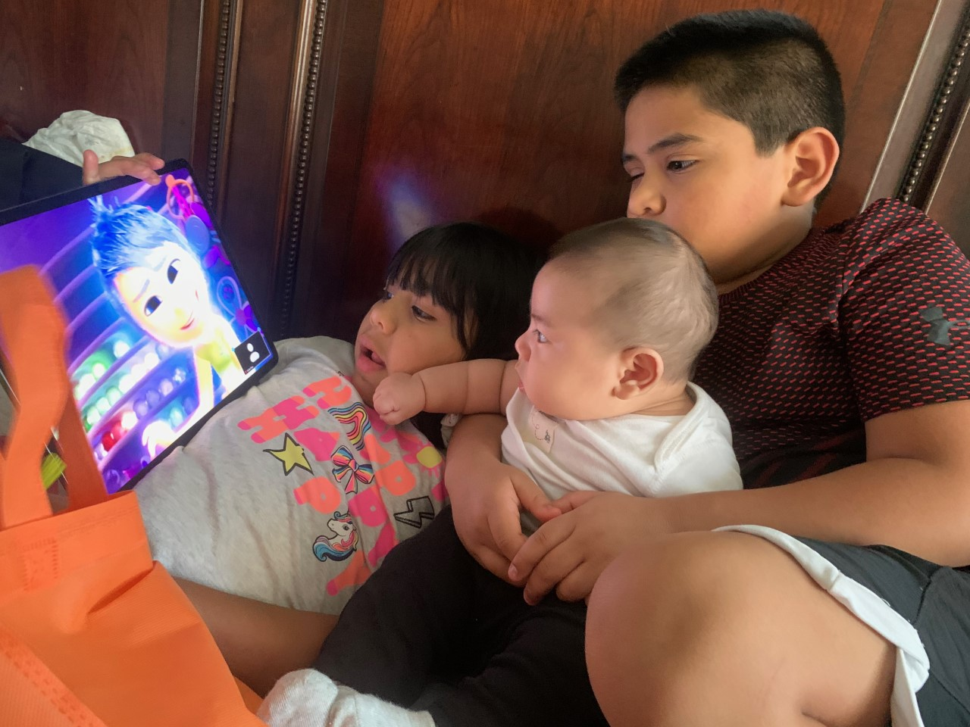


Other Virtual Programming

Slide 6
Thank You!
Questions?
© Copyright 2014 JHC. Proprietary and Confidential Information.

